Slide 1

Professionals are also engage in Reflection
Reflection involves thinking about the past, or ongoing experience of events, situations or actions to make sense of them, with a view of informing future choices, decisions and actions. In doing so we draw on existing ideas, our own or other peoples , and in applying them to our experience, we confirm or develop new ideas.

Slide 2
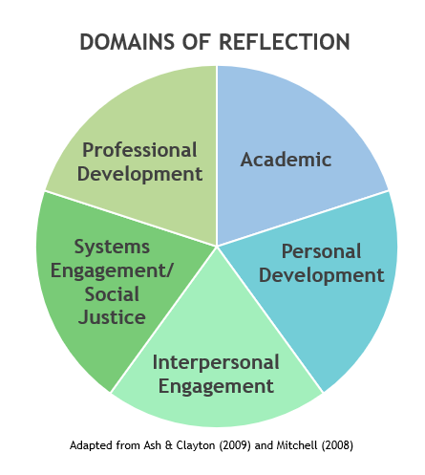
Reflection
What we really are asking you to do is to reflect about your levels of professionalism: where you are now, where you want to go and how you will get there.
Reflection is the primary way we change their behaviour.
EXAMINE THAT EXPERIENCE – DON’T JUST LIVE IT
Develop the ability to explore and examine your own experiences and actions because when you do you open up the possibility of purposeful learning from work and life.
Notes:
The appeal lies in linking learning with action and experience, in contrast to the academic tradition in which theories and ideas are used to prepare the student for experience in the future.
Reflection is a process that can result in a different understanding at the time and later.

Slide 3
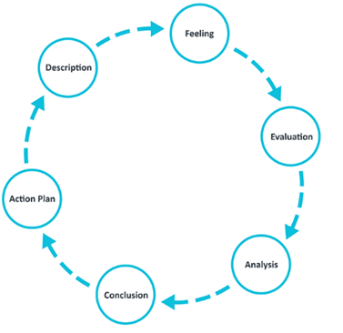
Graham Gibbs’ Reflective Cycle (1988)
2
1
3
6
4
5

Slide 4
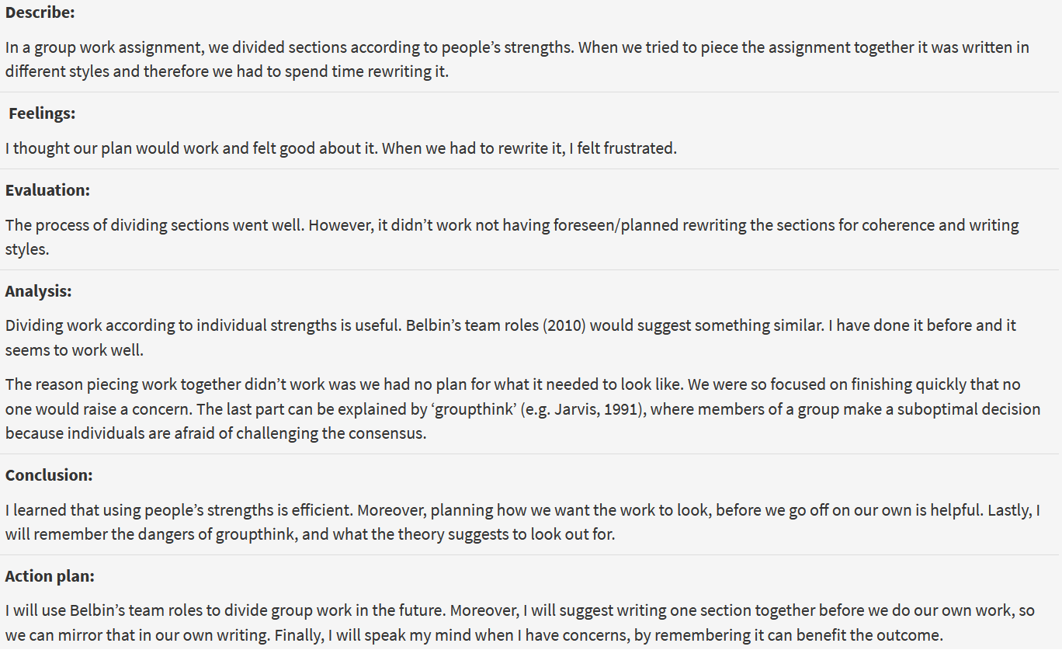

Slide 5


Experience
Noun. An event or occurrence which leaves an impression on someone
Breakout Room Activity
Examine the Experience!
Think about a peak experience - best work/meeting/most engaging presenter, completion of a particular task etc. Ask yourself (Reflect): What made the experience so successful? Share with the class.

